Slide 1
Volume of Prisms

Slide 2
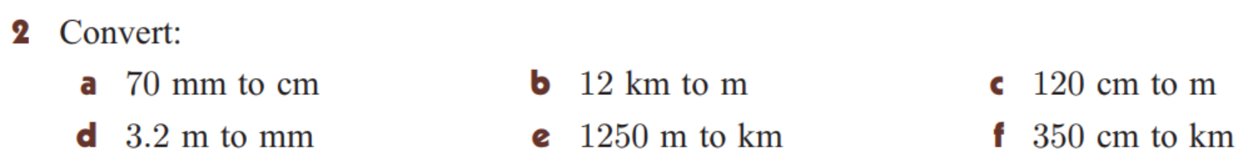
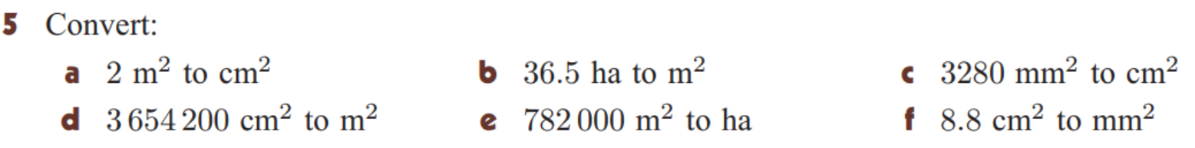
Do It Now:

Slide 3
Introduction to Volume
Learning Intentions
Success Criteria
By the end of this lesson, students will be able to:
Use 3-Dimensional Measurements and convert between them fluently
Determine the volume of prisms
I will know that I have been successful if I can:
Identify a strategy to convert units appropriately
State the formula for the volume of prisms

Slide 4
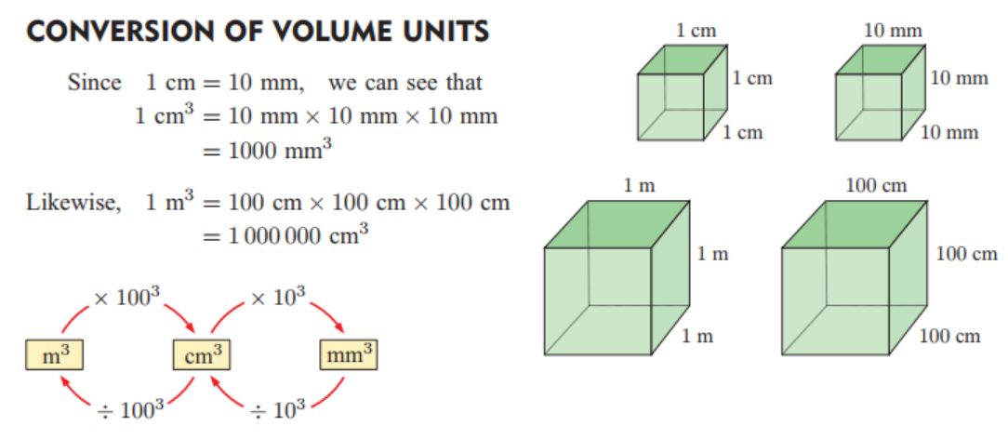
Information

Slide 5
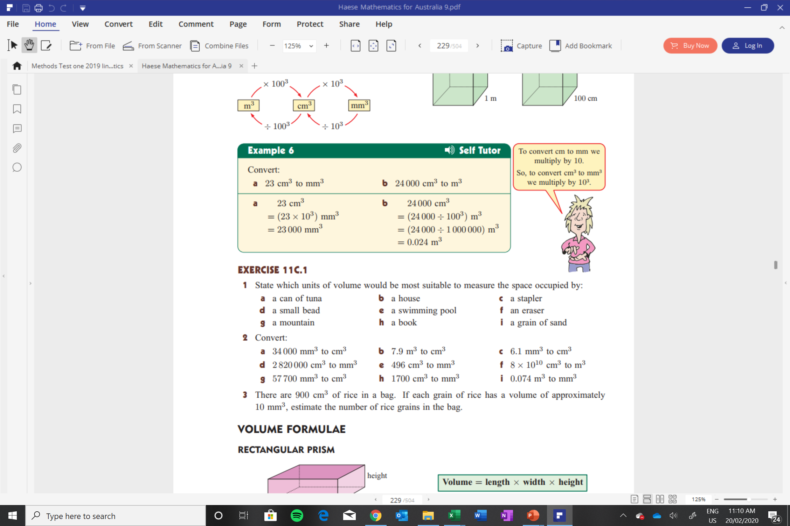

Slide 6
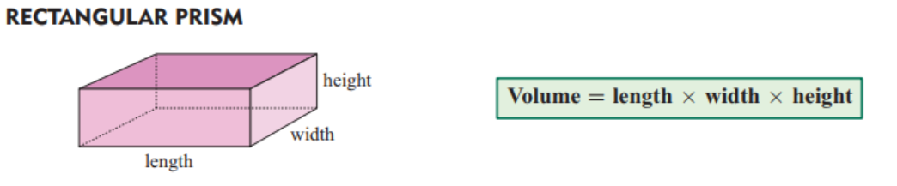
VOLUME:
Volume is how much space a 3-dimensional solid occupies.
It is different to capacity, which is how much a 3-dimensional solid can hold inside it.

Slide 7
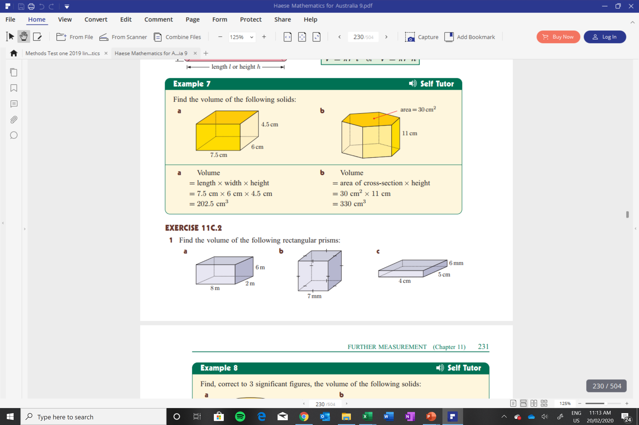
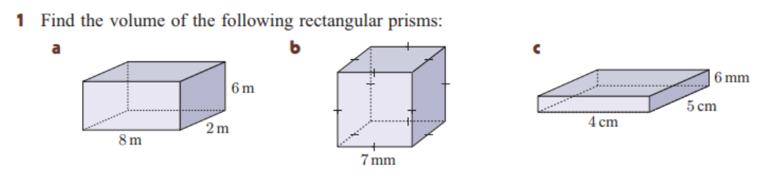

Slide 8
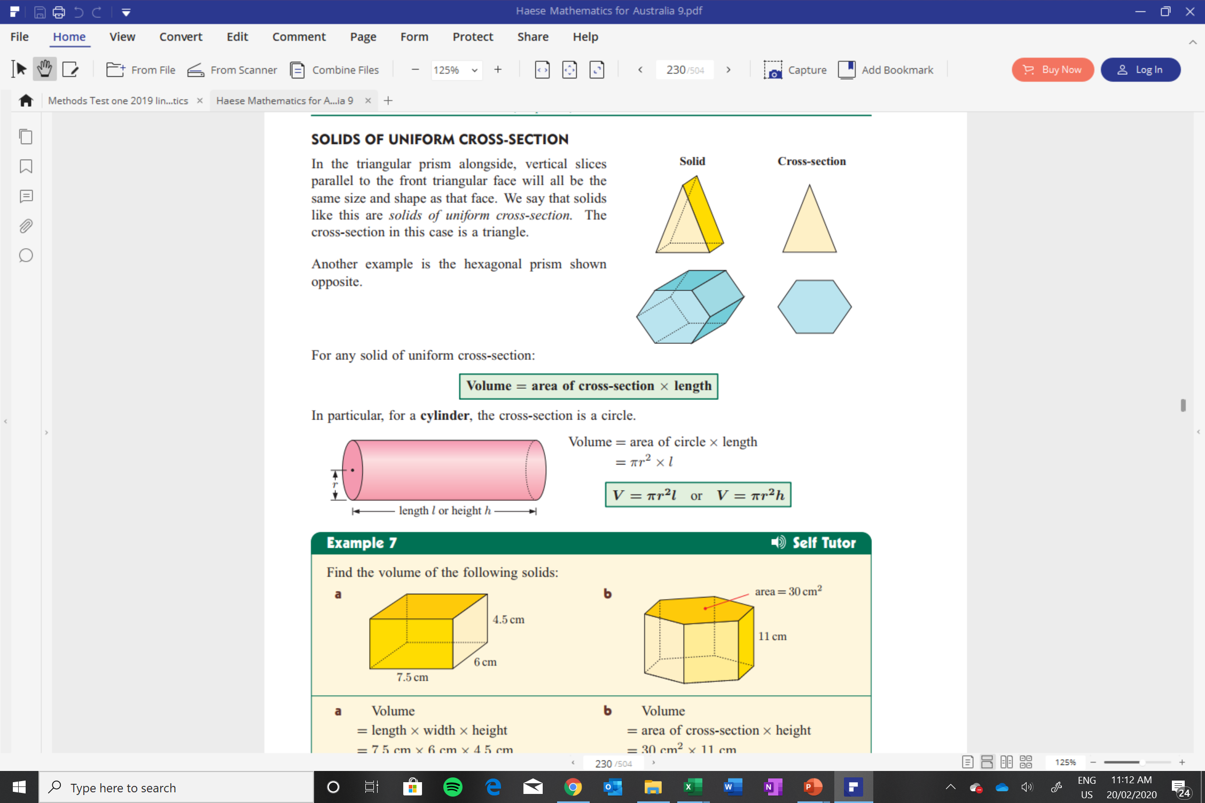

Slide 9
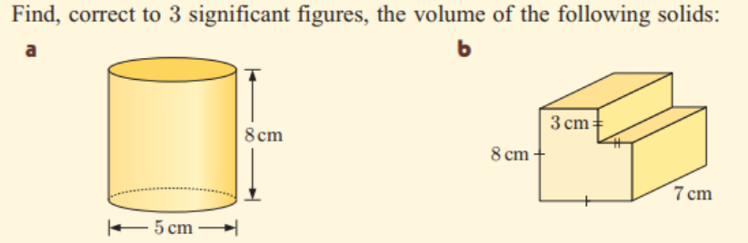
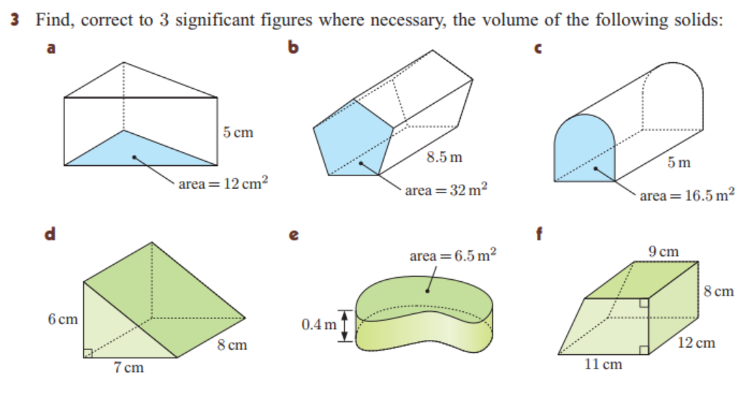

Slide 10
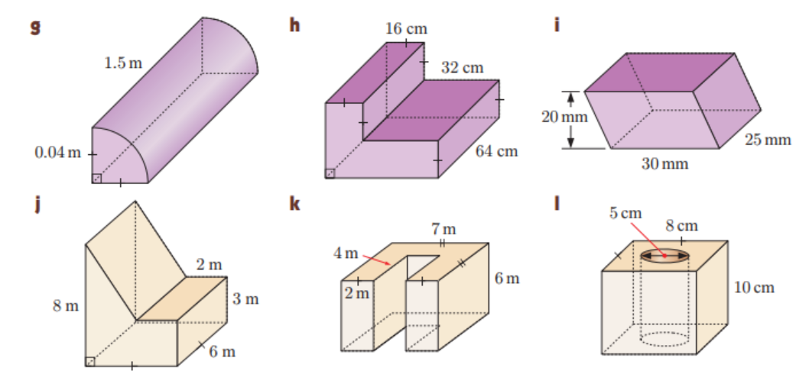

Slide 11

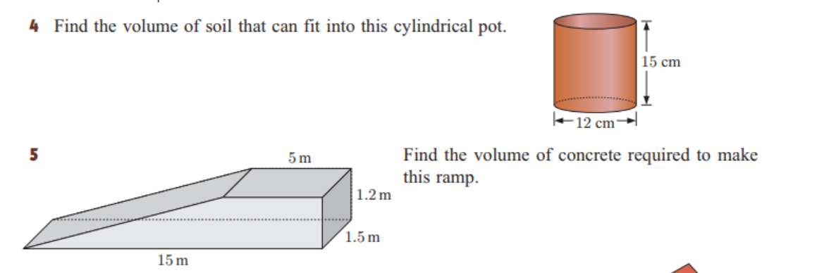

Slide 12
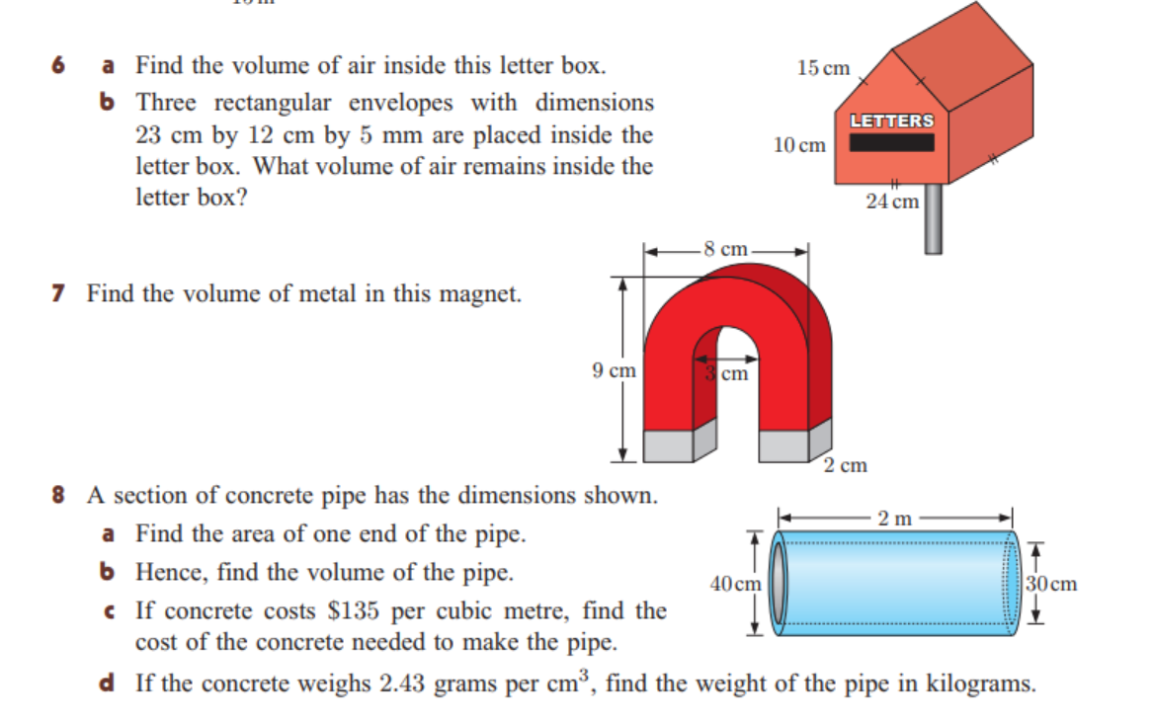

Slide 13
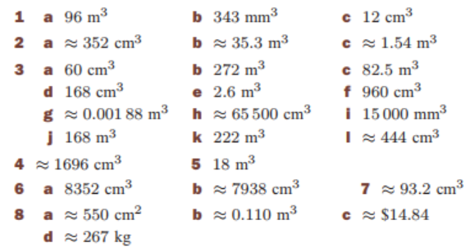
Solutions:

Slide 14
Homework:

